Slide 1

Damage Detection & Classification
of Fruits Using Image Processing Technique
Supervised by
Sadia Jahan
Lecturer
Department of CSE, City University
Presented by
SL. NO. | NAME | ID | BATCH | DEPT.
01 | Md. Emran Hasan | 152392002 | 39th | CSE
02 | Saiful Islam Sajon | 152392317 | 39th | CSE

Slide 2

Presentation Outline
Abstract
Introduction
Motivation
Objectives
Applications
Contribution
Related works
Proposed framework
Future work
Conclusion
References
Picture courtesy: Preparation Outline, Pi4i.com

Slide 3
Abstract
The food processing industry have been working with different kind of fruits. Most of the industries who are classifying the classes and the damages of fruit by manual. As a result of manual classification it will become a challenging task for human being. So, in this research work we are going to introduce a method for automatic fruit identification and damage detection based on Machine learning and Image processing technique.

Slide 4
Machine learning
Machine learning (ML) is a category of algorithm that allows software applications to become more accurate in predicting outcomes without being explicitly programmed. The basic premise of machine learning is to build algorithms that can receive input data and use statistical analysis to predict an output while updating outputs as new data becomes available.
Logistic Regression (LR)
Linear Discriminant Analysis (LDA)
K-nearest neighbor (KNN)
Decision Tree Classifier (CART)
Random Forest Classifier (RF)
Gaussian Naive Bayes (NB)
Support Vector Machine (SVM)
Notes:
Classification And Regression Tree (CART)

Slide 5
Research Challenges
Logistic Regression (LR)
Selecting Training and Testing dataset.
Notes:
Classification And Regression Tree (CART)

Slide 6
Proposed Method
Load Fruit Image Test/Train Dataset
Train Fruit Images
Test Fruit Images
Apply Image descriptor
Feature Extraction
Feature Extraction
Return Feature Vector
Train with SVM, LR, LDA, KNN, CART, RF, NB
Fit Training Data to the model
Prediction

Slide 7
Experimental Analysis
Dataset Description:
The resulted dataset has 55244 images of fruits spread across 81 labels.
The data set is available on GitHub and Kaggle.

Slide 8
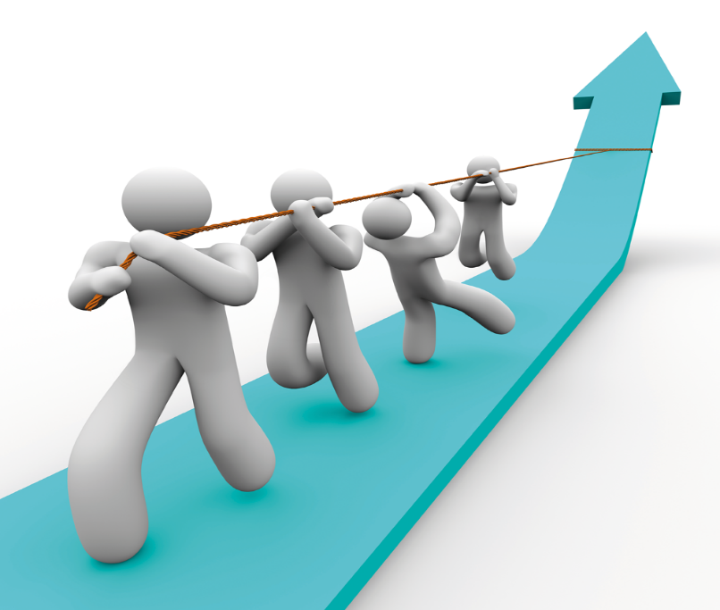
Future Works
Collecting data set and extract them.
Disease will be detected
Deep Learning will be applied
Implement the proposed methods.
Acquire a better accuracy rate.
Picture courtesy: http://www.sclance.com

Slide 9
Conclusion
Machine learning and image processing techniques will be very effective to classify and detect of fruit damage.
Our system will helps farmers to increase their productivity and yield with the help of automating tasks in garden/farm.
The more using of a large dataset will give better accuracy.

Slide 10
References
Mureşan, Horea, and Mihai Oltean. "Fruit recognition from images using deep learning." Acta Universitatis Sapientiae, Informatica 10, no. 1 (2018): 26-42.
Bhange, Manisha, and H. A. Hingoliwala. "Smart farming: Pomegranate disease detection using image processing." Procedia Computer Science 58 (2015): 280-288.
Awate, Ashwini, Damini Deshmankar, Gayatri Amrutkar, Utkarsha Bagul, and Samadhan Sonavane. "Fruit disease detection using color, texture analysis and ANN." In 2015 International Conference on Green Computing and Internet of Things (ICGCIoT), pp. 970-975. IEEE, 2015.

Slide 11
Thank you , everyone!

